Slide 1
EVOLUTION IN SOFTWARE PRODUCT LINES
BY TEAM 6
- Hariprasad Ravi Kumar
- Kavana Somanahalli Umesh
- Abhinav Pelapudi
- Tao Guo
- Jiamin Pan

Slide 2
CONTENTS
INTRODUCTION
PRODUCT LINE ACTIVITIES
EVOLUTION
BENEFITS
DRAWBACKS
CASE STUDY : SALION INC.
SALION ARCHITECTURE
CONCLUSION
REFERENCES

Slide 3
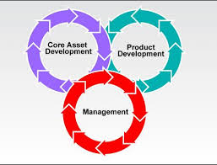
INTRODUCTION
Software-intensive systems that share a common, managed set of features
Set of related software products that are generated from reusable assets
‘Products are related’ refers to the common functionalities they share
Emerging as an important development paradigm in today’s world
Product line development involves three essential activities:
- core asset development
- product development
- management

Slide 4
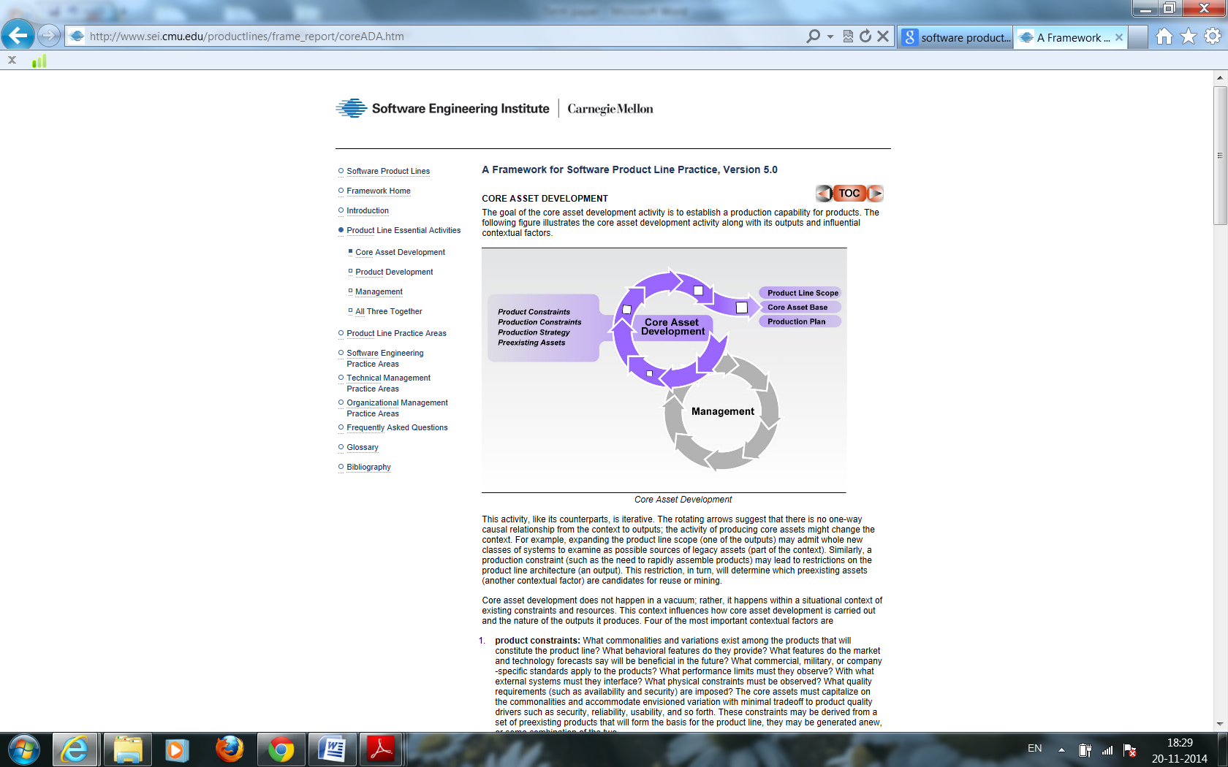
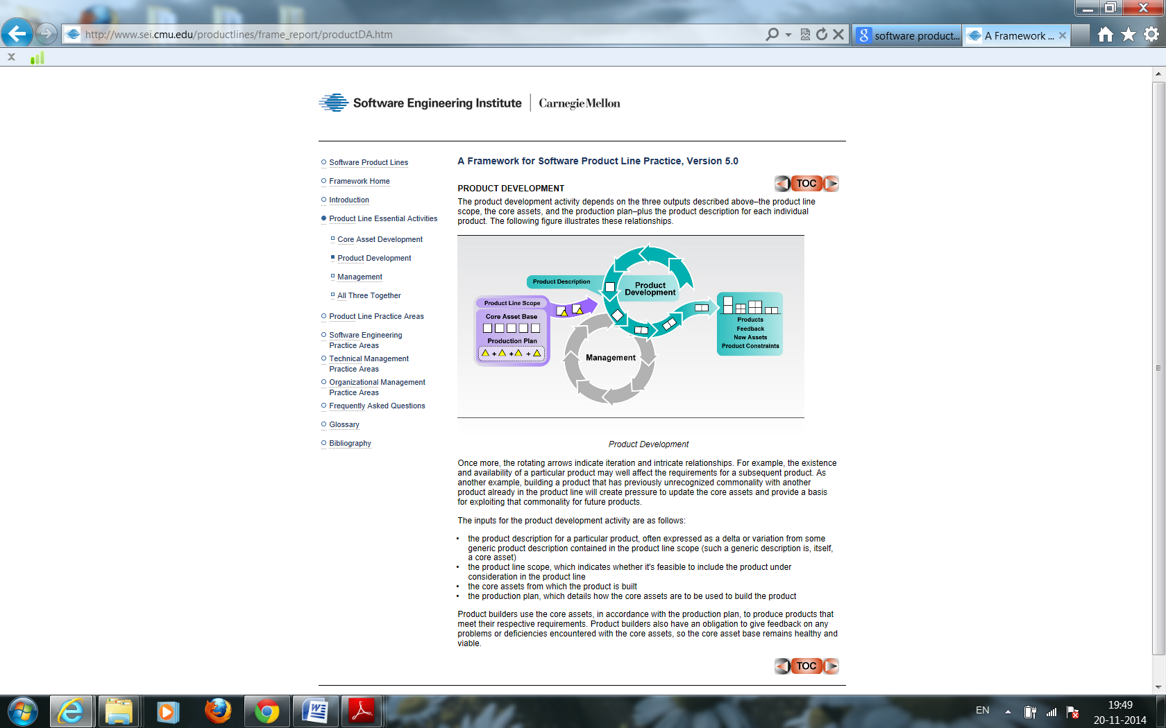
PRODUCT LINES ACTIVITIES
CORE ASSET DEVELOPMENT
Goal : Establish a production capability for products and creation & maintenance of artifacts
PRODUCT DEVELOPMENT
Depends on 3 outputs of previous activity plus product description for each product
MANAGEMENT
Two categories:
Organizational
Technical

Slide 5
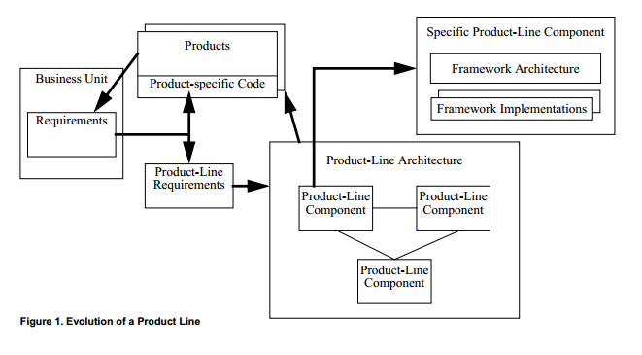

EVOLUTION
The first generation of software product line case studies – from the 1980’s and 1990’s – described patterns of software development behavior
Contemporary literature presents one particular approach to adopting a product line
Evolution is complicated by the fact that evolution of a single asset can affect many other assets and multiple products
Changes made to one asset are propagated to other assets
One asset might constrain the design or structure of another

Slide 6
BENEFITS
Large scale productivity gains
Increase product quality
Efficient use of human resources
Increased customer satisfaction
Ability to maintain market presence
INDIVIDUAL BENEFITS
Productivity gains, sustained growth and market presence
Explore new markets,
New technology
High-quality products, predictable delivery date, predictable cost
Ability to quickly develop new products

Slide 7
DRAWBACKS
Dependencies because of reusable components
Difficulties with product line scope
Complexity
Involves risk
Needs long term management
Not scalable
Designing architecture is difficult

Slide 8
CASE STUDY: SALION INC.
Salion Inc. : An enterprise software company that helps suppliers optimize their revenue acquisition process
Organizations begin a software product line by developing the core assets
Salion follows reactive approach
This approach has the advantage of a much lower cost of entry to software product lines
Salion’s Product Line
Salion’s solution is a set of three software applications
- Salion Revenue Process Manager
- Salion Knowledge Manager
- Salion Business Link

Slide 9
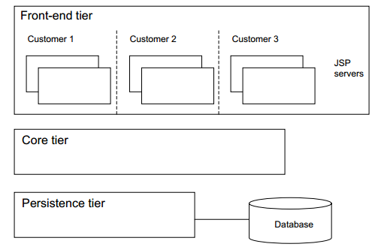
SALION ARCHITECTURE
Scoping
Understanding Relevant Domains
Process Definition
Architecture Definition
COTS Utilization
Tool Support
Marketing
Customer Interface Management
Operations
Data Collection, Metrics, and Tracking
Structuring the Organization
Salion’s system line product architecture

Slide 10
CONCLUSION
All the assets of a product line organization will evolve over time, and there are many initiating forces:
• Users want more features or the latest technology for existing features
• People learn new skills or improve the ones they already possess
• New standards are developed and existing standards are upgraded
• Vendors phase out products and offer new ones
Software product lines have received wide adoption in many software companies and have proven to be very successful in achieving intra organizational reuse

Slide 11
REFERENCES
http://www.janbosch.com/articles/splmaturity.pdf
http://www.engr.sjsu.edu/fayad/current.courses/cmpe296g-spring05/docs/06-Evolution_in_PLA.pdf
http://biglever.org/papers/Krueger_SPLC2006_NewMethods.pdf
http://www.sei.cmu.edu/reports/03tr005.pdf
http://www.se.fudan.edu.cn/paper/ourpapers/201.pdf
http://www.sei.cmu.edu/productlines/
http://www.program-transformation.org/pub/GPCE11/ConferenceProgram/gpce11-neves.pdf

Slide 12
THANK YOU ☺

